Slide 1
Rockbuster Stealth Data Analysis
Ky Trac

Slide 2
Overview and objective
Rockbuster Stealth LLC is a movie rental company that used to have stores around the world. Facing stiff competition from streaming services such as Netflix and Amazon Prime, the Rockbuster Stealth management team is planning to use its existing movie licenses to launch an online video rental service in order to stay competitive.
Our focus will be on the analysis of Rockbuster's current customers and inventory to solve the following key questions:
Which movies contributed the most/least to revenue gain?
What was the average rental duration for all videos?
Which countries are Rockbuster customers based in?
Where are customers with a high lifetime value based?
Do sales figures vary between geographic regions?

Slide 3
Rockbuster data summary
Total revenue - $61312.04
Total number of customer – 599
Total number of rentals – 16044
Total number of inventory – 4581
Number of countries who are customers – 109

Slide 4
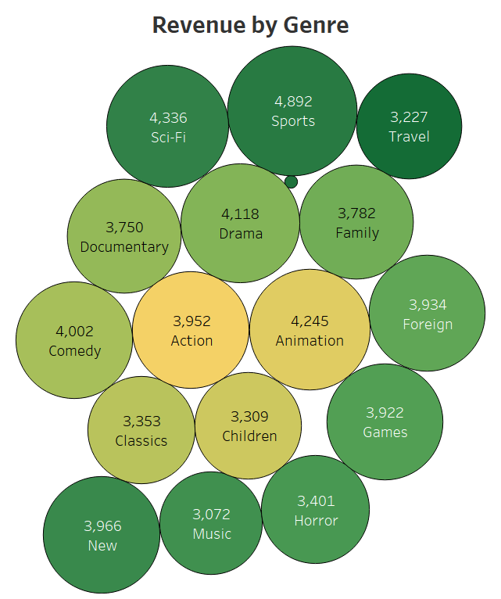
Which movies contributed the most/least to revenue gain?
Top 10 Film with the Highest Revenue
Title | Rating | Genre | Total Revenue
Telegraph Voyage | PG | Music | $215.75
Zorro Ark | NC-17 | Comedy | $199.72
Wife Turn | NC-17 | Documentary | $198.73
Innocent Usual | PG-13 | Foreign | $191.74
Hustler Party | NC-17 | Comedy | $190.78
Saturday Lambs | G | Sports | $190.74
Titans Jerk | PG | Sci-Fi | $186.73
Harry Idaho | PG-13 | Drama | $177.73
Torque Bound | G | Drama | $169.76
Dogma Family | G | Animation | $168.72
Thriller is the only genre that did not produce a significant revenue, compared to all the other genre.
Top 10 Film with the Lowest Revenue
Title | Rating | Genre | Total Revenue
Oklahoma Jumanji | PG | New | $5.94
Duffel Apocalypse | G | Documentary | $5.94
Texas Watch | NC-17 | Horror | $5.94
Freedom Cleopatra | PG-13 | Comedy | $5.95
Young Language | G | Documentary | $6.93
Rebel Airport | G | Music | $6.93
Cruelty Unforgiven | G | Classics | $6.94
Treatment Jekyll | PG | Drama | $6.94
Lights Deer | R | Classics | $7.93
Japanese Run | G | Horror | $7.94
All genres made significant contributions to Rockbuster's revenue.

Slide 5
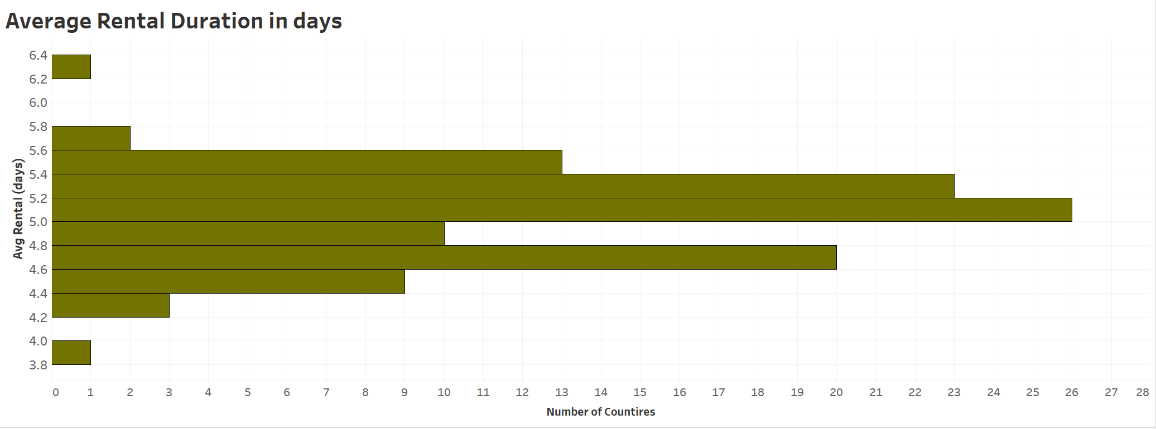
What was the average rental duration for all videos?
Genre | Avg Rental Period
Thriller | 6 days
Sports | 4 days
Comedy | 4 days
Games | 4 days
Music | 4 days
Sci-Fi | 4 days
Documentary | 4 days
Family | 4 days
New | 4 days
Horror | 4 days
Foreign | 4 days
Action | 4 days
Classics | 4 days
Children | 4 days
Animation | 4 days
Drama | 4 days
Travel | 4 days
Movie Rating | Avg Rental Period
PG-13 | 5.08 days
G | 5.04 days
NC-17 | 5.04 days
PG | 5 days
R | 4.96 days
Roughly all countries has an average rental period on 5 days.
The average rental duration for all videos is approximately five days.
Across genres, the range of rental period is 4 days, with thriller being the outlier.

Slide 6
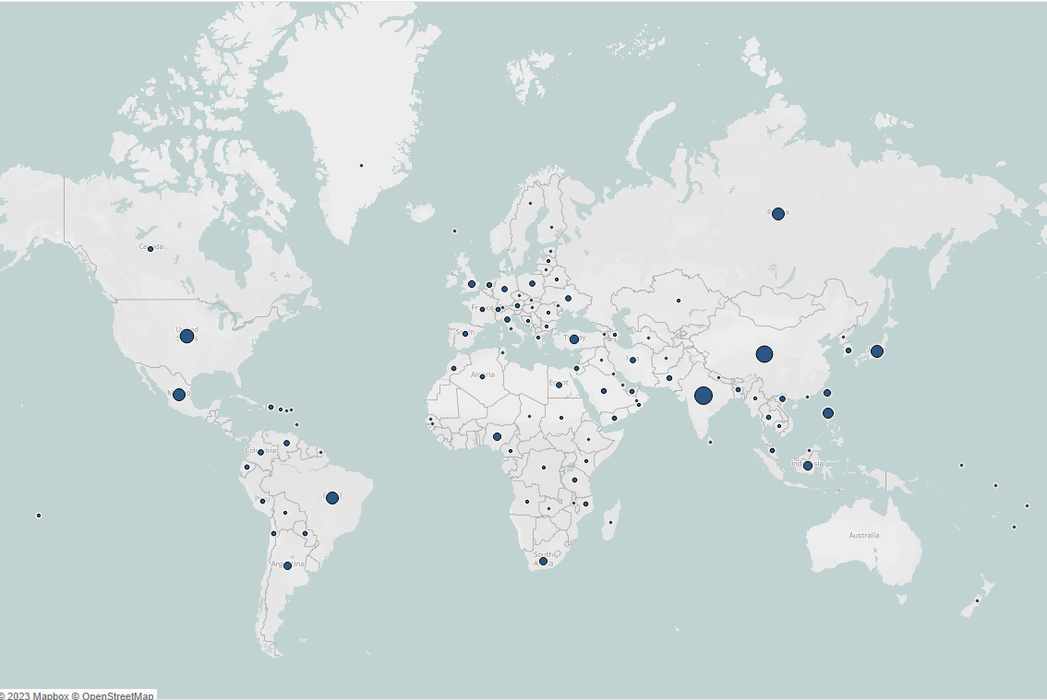
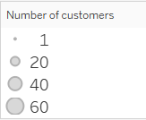
Which countries are Rockbuster customers based in?
Rockbuster customers are based in over 108 countries
Top 10 Countries
India
China
United States
Japan
Mexico
Brazil
Russian Federation
Philippines
Turkey
Indonesia
Number of Customer by Country

Slide 7
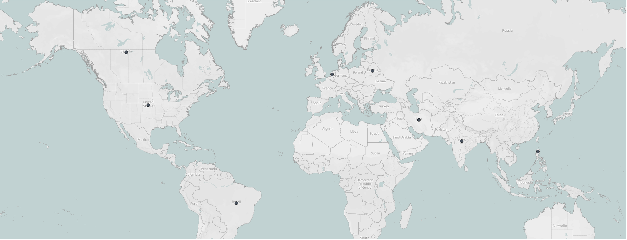
Where are customers with a high lifetime value based?
Name and Location of High Value Customer
Name | City | Country | Total spending
Eleanor Hunt | Saint-Denis | Runion | $211.55
Karl Seal | Cape Coral | United States | $208.58
Marion Snyder | Santa Brbara dOeste | Brazil | $194.61
Rhonda Kennedy | Apeldoorn | Netherlands | $191.62
Clara Shaw | Molodetno | Belarus | $189.60
Tommy Collazo | Qomsheh | Iran | $183.63
Ana Bradley | Memphis | United States | $167.67
Curtis Irby | Richmond Hill | Canada | $167.62
Marcia Dean | Tanza | Philippines | $166.61
Mike Way | Valparai | India | $162.67
High Value Customers by location

Slide 8
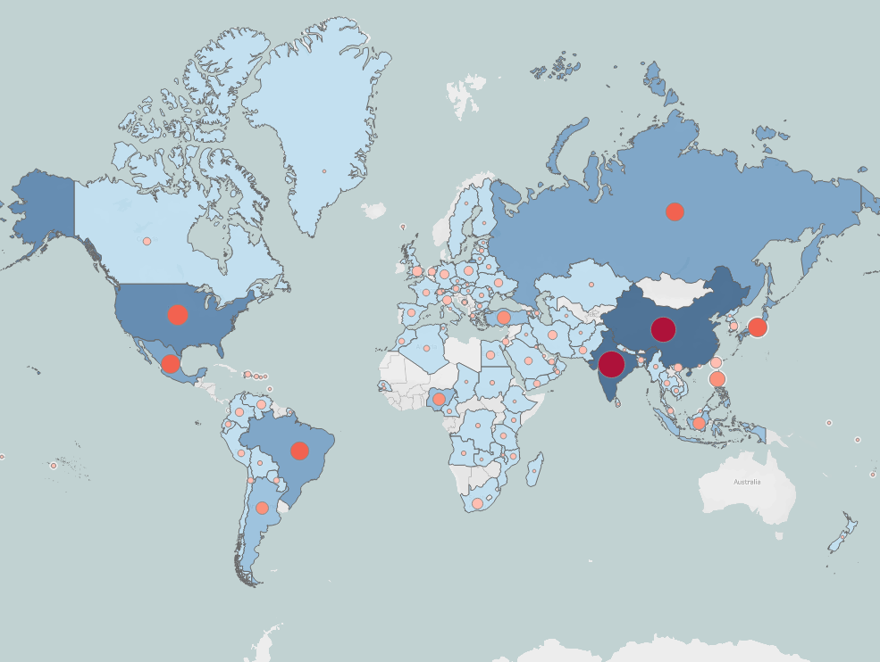
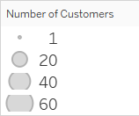


Do sales figures vary between geographic regions?
Countries in the Asia region produce the most revenue.
while the United States and Mexico produce the most revenue in North America.
Brazil generates the most revenue for South America.
These regions and countries are also home to the majority of Rockbox users.

Slide 9
RECOMMENDATIONS
Concentrate activities in the Asia and North America regions, as these countries have produced the most revenue. In addition, most of the company's customers live in those countries.
Formulate a plan to promote expansion in Europe.
Increase the movie library across all genres and rating types.
Start a rewards program for high value customers to reward them for their loyalty.
Create a basic reward for the other customers to gain their business.

Slide 10
Questions

